Slide 1
A Multidimensional Approach to Multi-Phase Flow Instrumentation Using Capacitive Sensors
Qussai Marashdeh, Tech4Imaging LLC
Fernando Teixeira, OSU

Slide 2
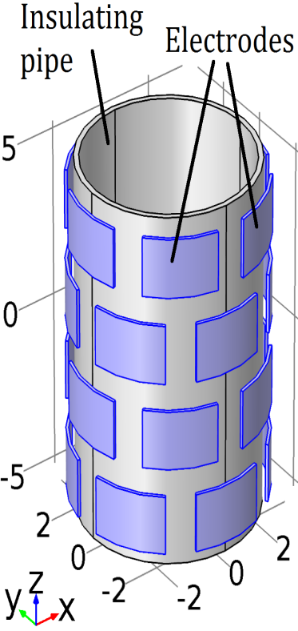
ECVT: basics
ECVT:
Used for imaging multiphase flows based on dielectric properties of materials, e.g. $ε_{air}=1,ε_{oil}≈3,ε_{water}=81.$
System works in the quasi-static range and is governed by Poisson’s equation:
$∇ε\left(x,y,z\right)∇φ\left(x,y,z\right)=−ρ\left(x,y,z\right)$
where
$ε\left(x,y,z\right)$: volumetric permittivity distribution
$φ\left(x,y,z\right)$: electric potential distribution
$ρ\left(x,y,z\right)$: charge density
Electrodes are excited one at a time and the inter-electrode capacitances are measured.
The volumetric permittivity distribution $ε\left(x,y,z\right)$ is reconstructed from the measured capacitances and visualized as a 3D or 2D image.
Capacitance measuring circuitry
Data & control
Computer for image reconstruction
ECVT sensor
Volumetric, i.e. 3D image
Image reconstruction steps in ECVT

Slide 3
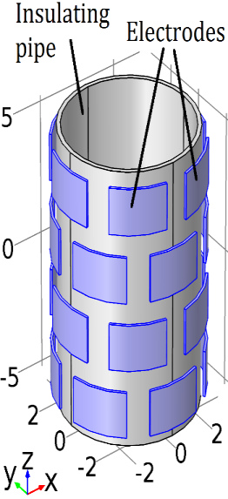
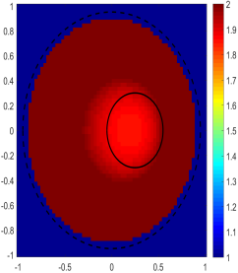
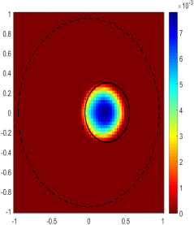
Dual Modality Concept
Dual Modality
Two 3D images in two independent dimensions
Feature extraction is enabled through both images
Data acquisition and image reconstruction
3D Image 1
Feature Extraction
3D Image 2
Processing
$$∆t$$
ECVT sensor
Cap.
DCPT

Slide 4
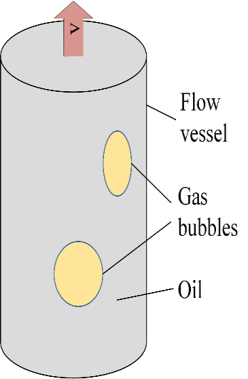
Imaging for non-homogeneous flows
Scope:
Non-homogeneous multiphase flows
Example in processing technology: fluidized bed, wet gas separator, gas-oil flow in pipelines.
Solution:
ECVT for one phase
DCPT for another phase
Water
Three Phase Flow

Slide 5
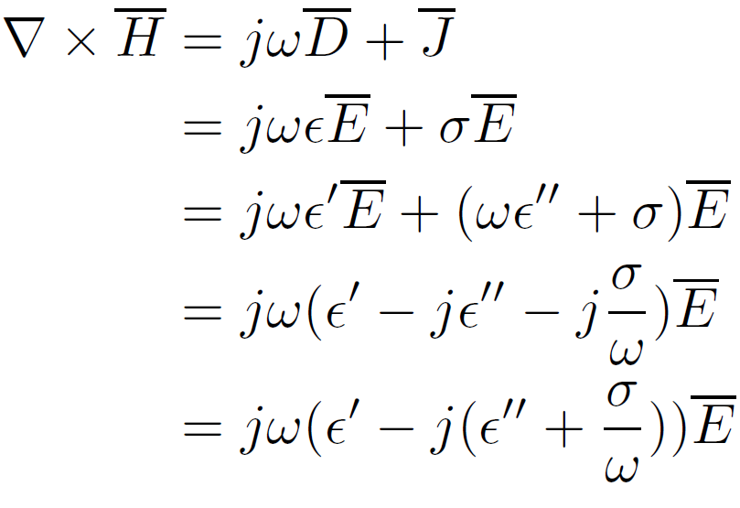
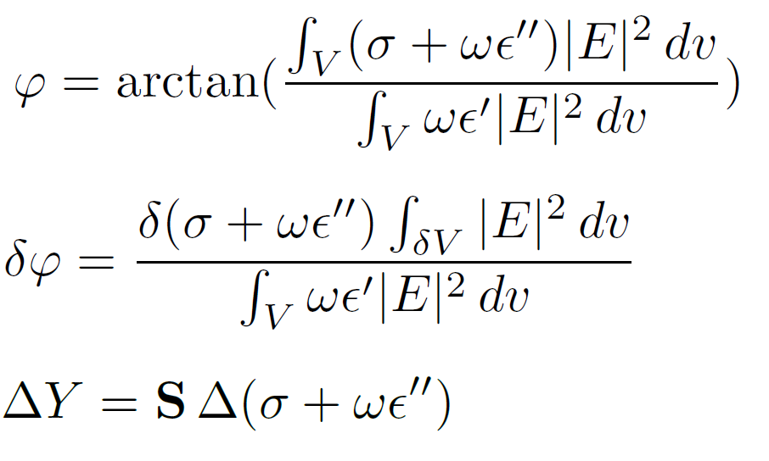
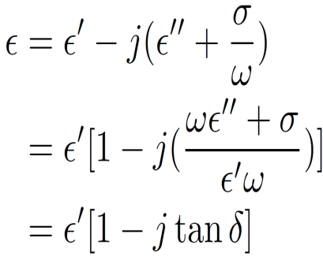
Phase: DCPT Formulation
$\frac{σ+ωε^{′′}}{ωε^{′}}$ << 1
$δ=\sqrt{\frac{2}{ωμσ}}$ $≫Object Size$
$$λ≫Object Size$$

Slide 6
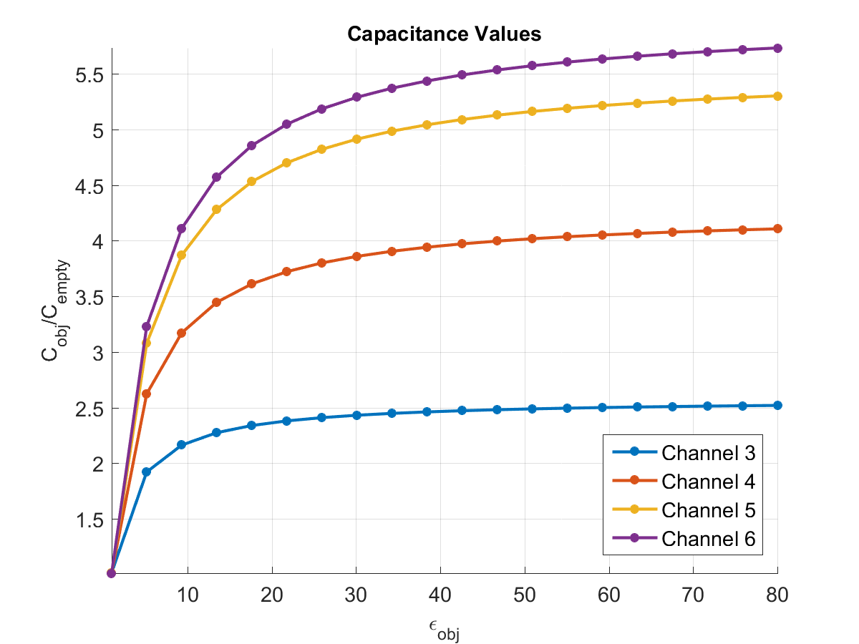
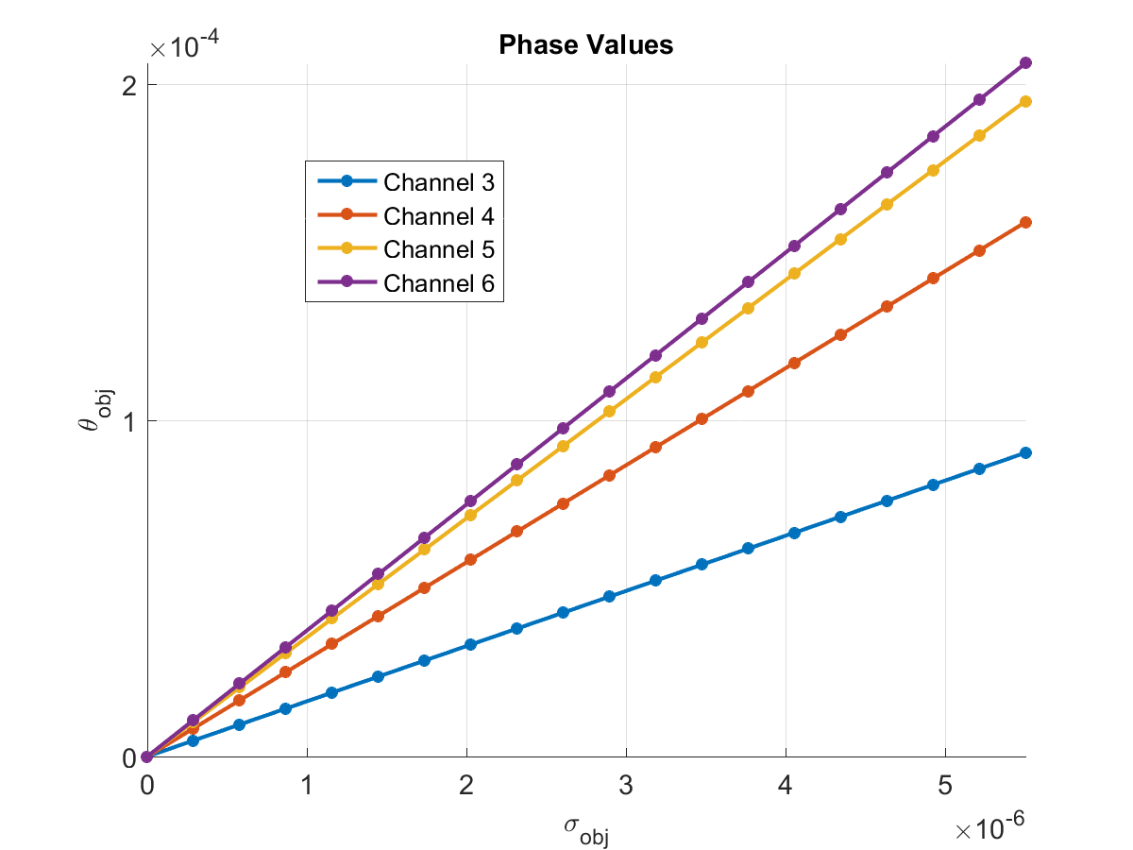
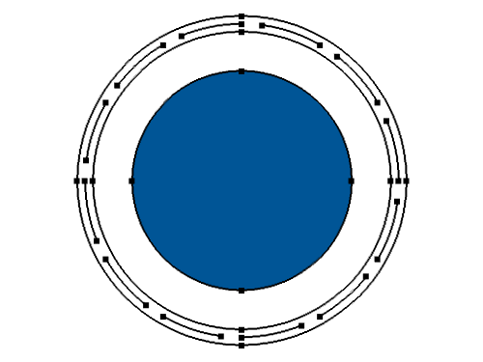
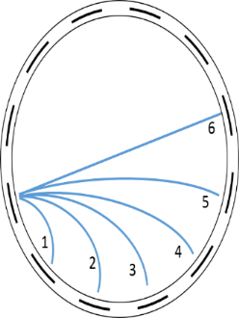
ECT and DCPT Behavior
Object Size is held constant but the material property is changed
$$Air$$
$$Water$$
$ε={80ε}_{0}$ $σ=5.5{×10}^{−6}\left(\frac{S}{m}\right)$
$$f=300kHz λ=1000m$$
$$δ=\sqrt{\frac{2}{ωμσ}}≈392m$$
$$\frac{σ}{ωε}\sim 4{×10}^{−3}$$

Slide 7
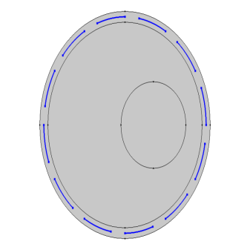
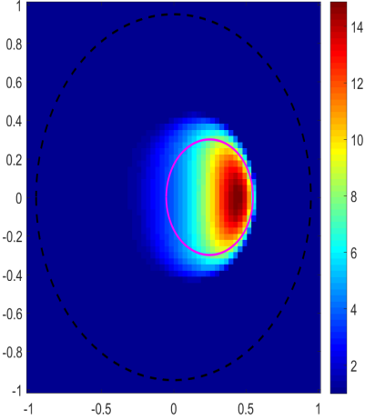
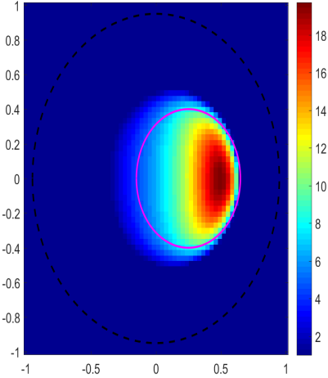
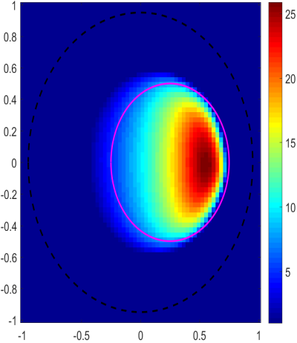
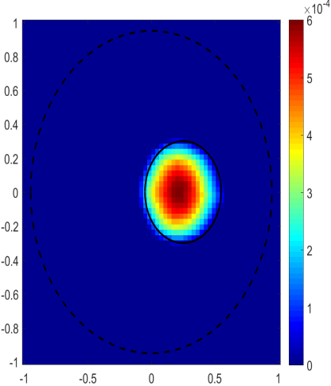
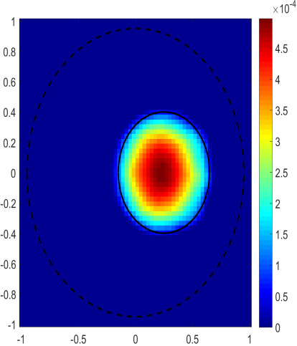
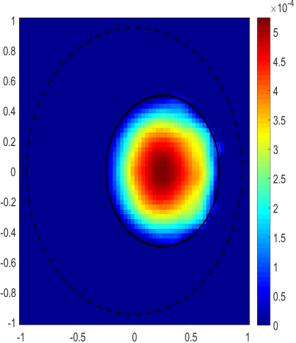
ECT and DCPT Comparison with Simulations
$ε={80ε}_{0}$ $σ=5.5{×10}^{−6}\left(\frac{S}{m}\right)$
$$f=300kHz λ=1000m$$
$$δ=\sqrt{\frac{2}{ωμσ}}≈392m$$
$$\frac{σ}{ωε}\sim 4{×10}^{−3}$$
$$64×64 \text{Pixels}$$
$$Air$$
$$Water$$
ECT
DCPT

Slide 8
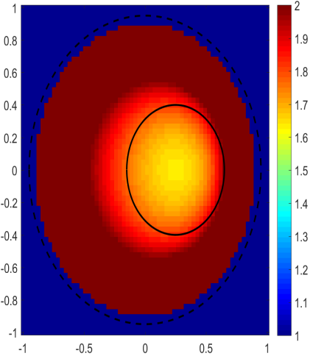
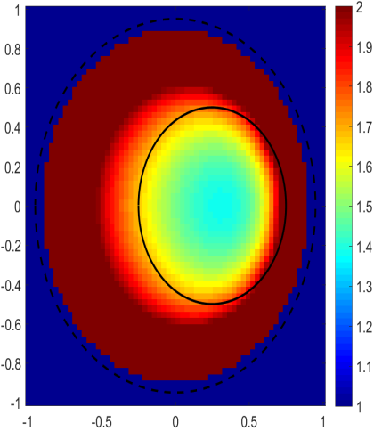
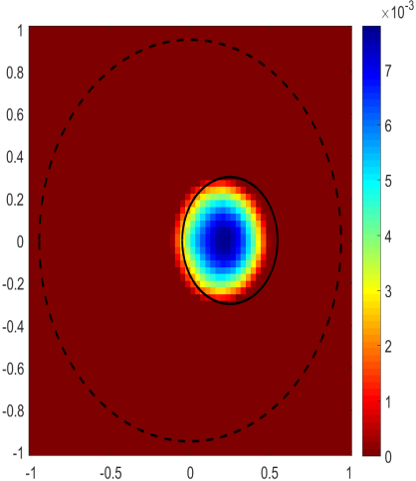
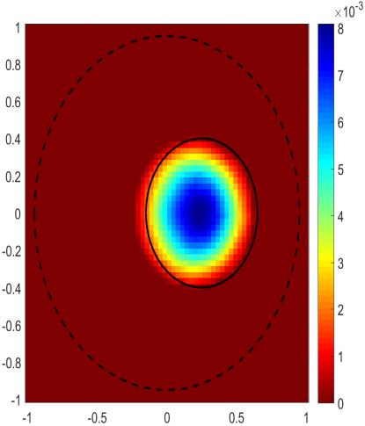
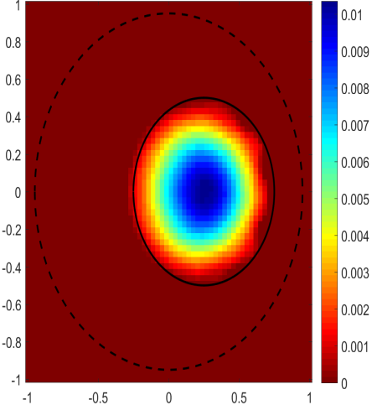
ECT and DCPT Comparison with Simulation 2
$ε={80ε}_{0}$ $σ=5.5{×10}^{−6}\left(\frac{S}{m}\right)$
$$f=300kHz λ=1000m$$
$$δ=\sqrt{\frac{2}{ωμσ}}≈392m$$
$$\frac{σ}{ωε}\sim 4{×10}^{−3}$$
$$64×64 \text{Pixels}$$
$$Water$$
$$Air$$
ECT
DCPT

Slide 9
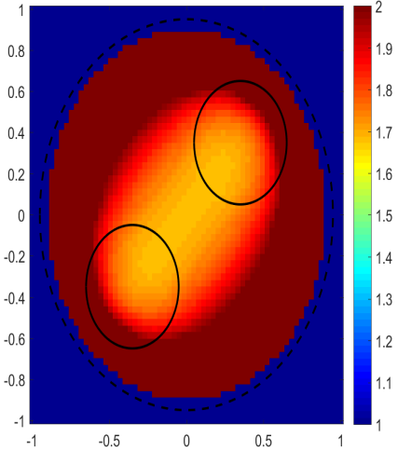
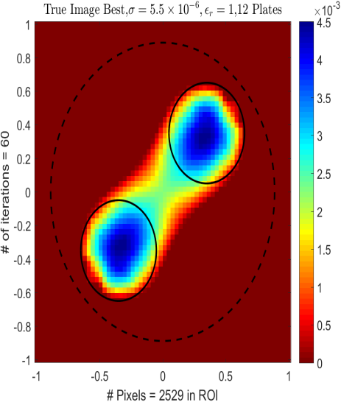
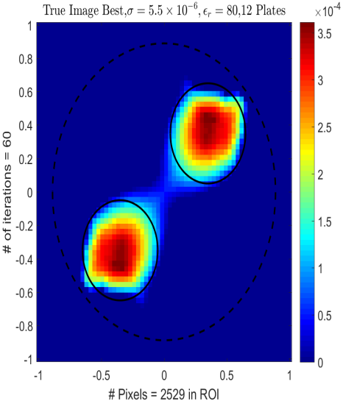
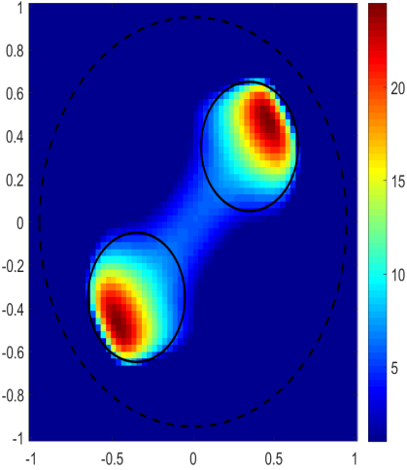
ECT and DCPT Comparison with Simulation 3
$ε={80ε}_{0}$ $σ=5.5{×10}^{−6}\left(\frac{S}{m}\right)$
$$f=300kHz λ=1000m$$
$$δ=\sqrt{\frac{2}{ωμσ}}≈392m$$
$$\frac{σ}{ωε}\sim 4{×10}^{−3}$$
$$64×64 \text{Pixels}$$
$ε,σ$
$$Air$$
$$Air$$
$$Water$$
$$Water$$
$$Air$$
$$Water$$
ECT
DCPT
ECT
DCPT

Slide 10
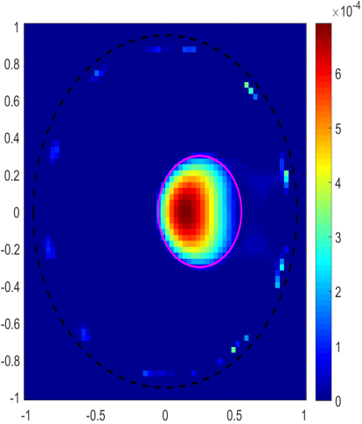
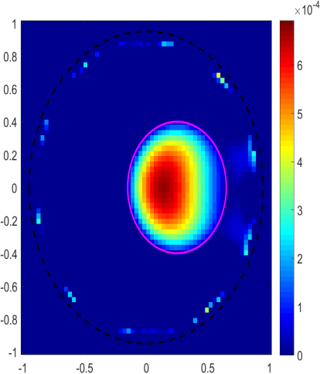
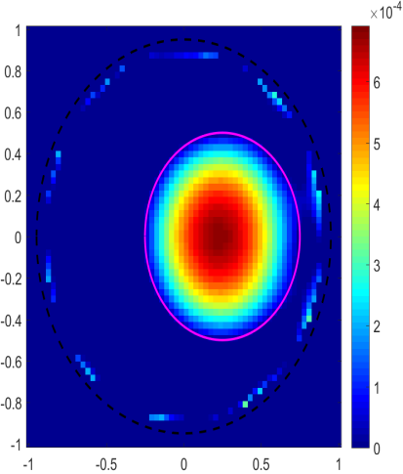
DCPT Usage of abs(S) - 1
$ε={80ε}_{0}$ $σ=5.5{×10}^{−6}\left(\frac{S}{m}\right)$
$$f=300kHz λ=1000m$$
$$δ=\sqrt{\frac{2}{ωμσ}}≈392m$$
$$\frac{σ}{ωε}\sim 4{×10}^{−3}$$
$$64×64 \text{Pixels}$$
$$Air$$
$$Water$$
Conventional S
Abs(S)

Slide 11
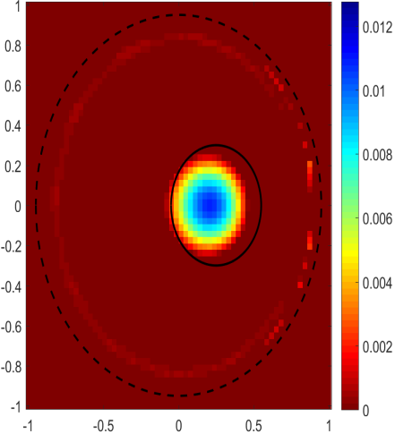
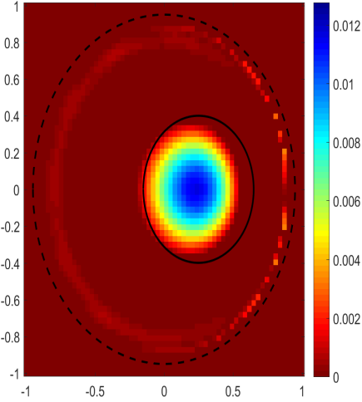
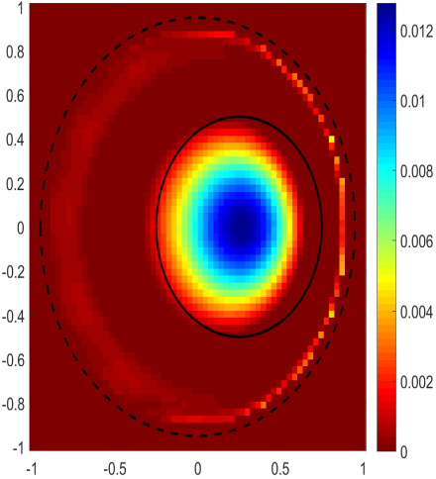
DCPT Usage of abs(S) - 2
$ε={80ε}_{0}$ $σ=5.5{×10}^{−6}\left(\frac{S}{m}\right)$
$$f=300kHz λ=1000m$$
$$δ=\sqrt{\frac{2}{ωμσ}}≈392m$$
$$\frac{σ}{ωε}\sim 4{×10}^{−3}$$
$$64×64 \text{Pixels}$$
$$Water$$
$$Air$$
Conventional S
Abs(S)

Slide 12
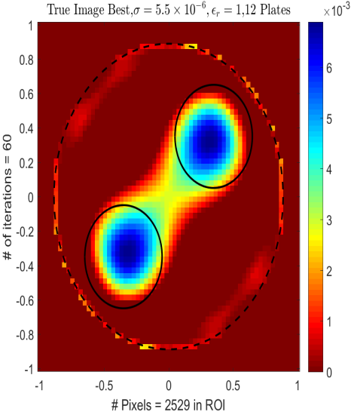
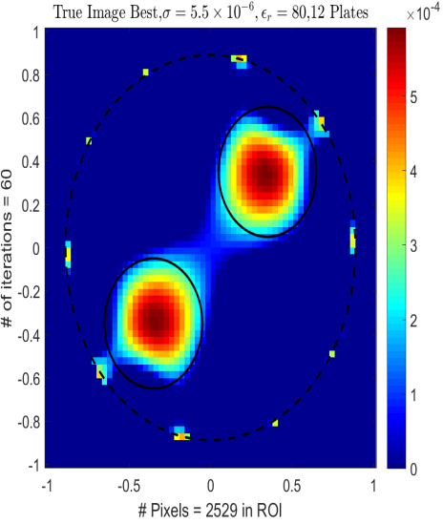
DCPT Usage of abs(S) - 3
$ε={80ε}_{0}$ $σ=5.5{×10}^{−6}\left(\frac{S}{m}\right)$
$$f=300kHz λ=1000m$$
$$δ=\sqrt{\frac{2}{ωμσ}}≈392m$$
$$\frac{σ}{ωε}\sim 4{×10}^{−3}$$
$$64×64 \text{Pixels}$$
$ε,σ$
$$Air$$
$$Air$$
$$Water$$
$$Water$$
$$Air$$
$$Water$$
Conventional S
Abs(S)
Conventional S
Abs(S)

Slide 13
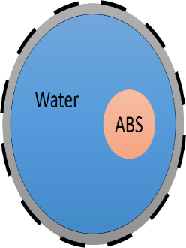
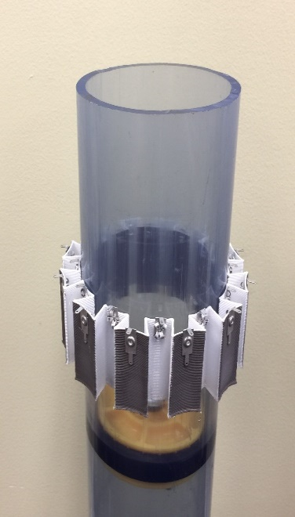
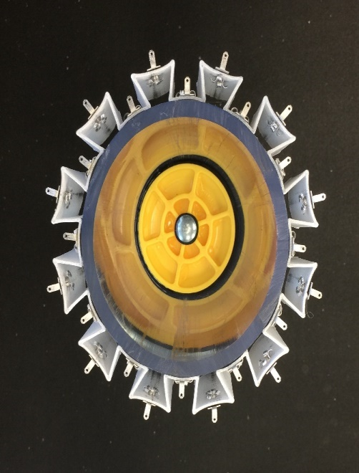
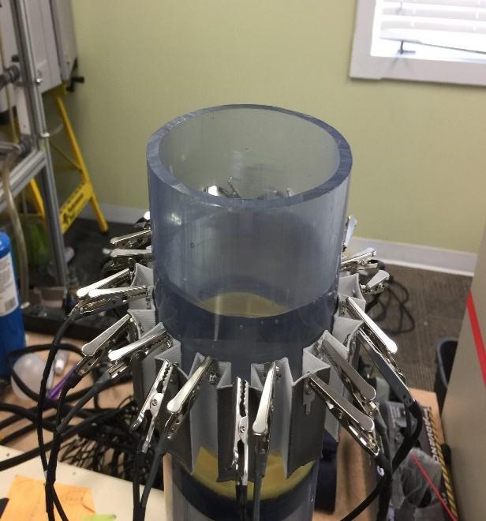
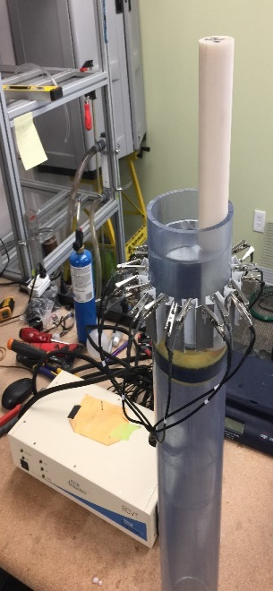
DCPT Experiment
$ε={80ε}_{0}$ $σ=5.5{×10}^{−6}\left(\frac{S}{m}\right)$
$$f=2MHz λ=150m$$
$$δ=\sqrt{\frac{2}{ωμσ}}≈151m$$
$$\frac{σ}{ωε}\sim 6{×10}^{−5}$$

Slide 14
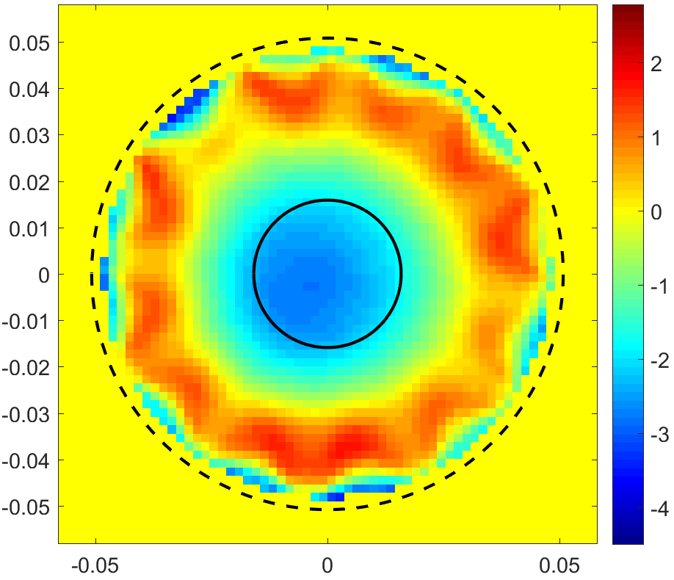
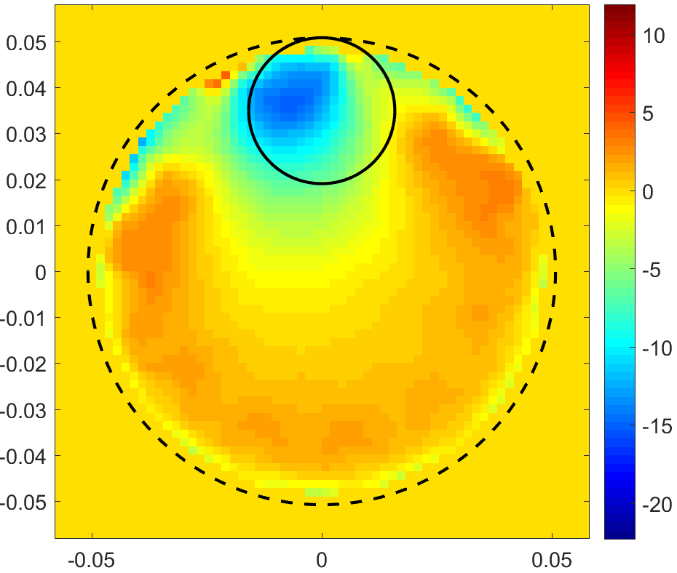
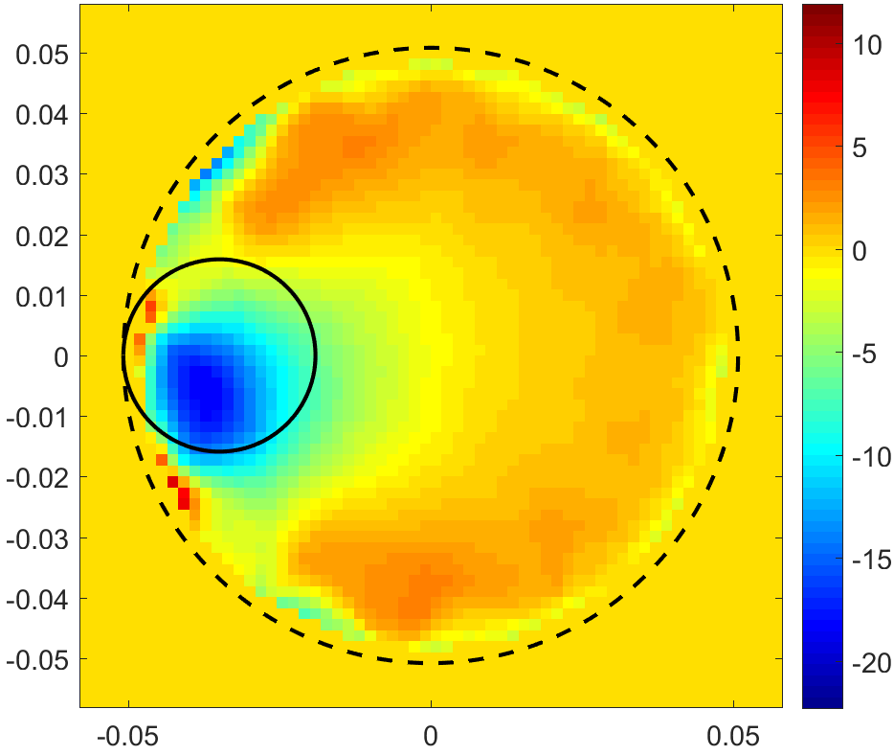
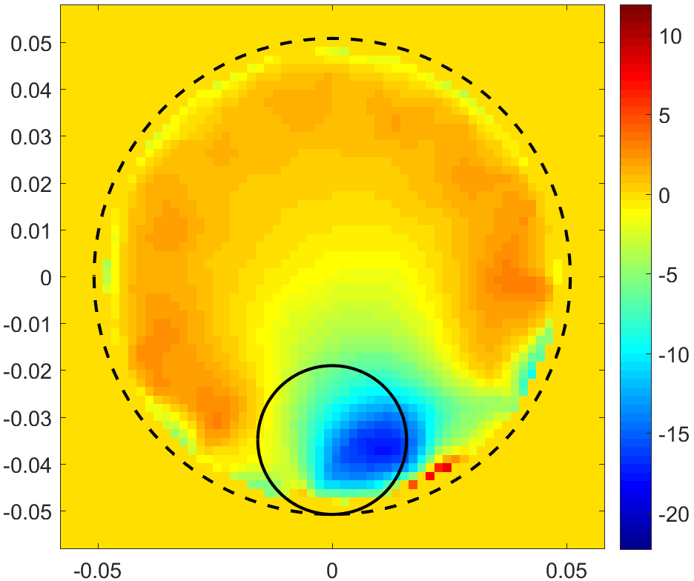
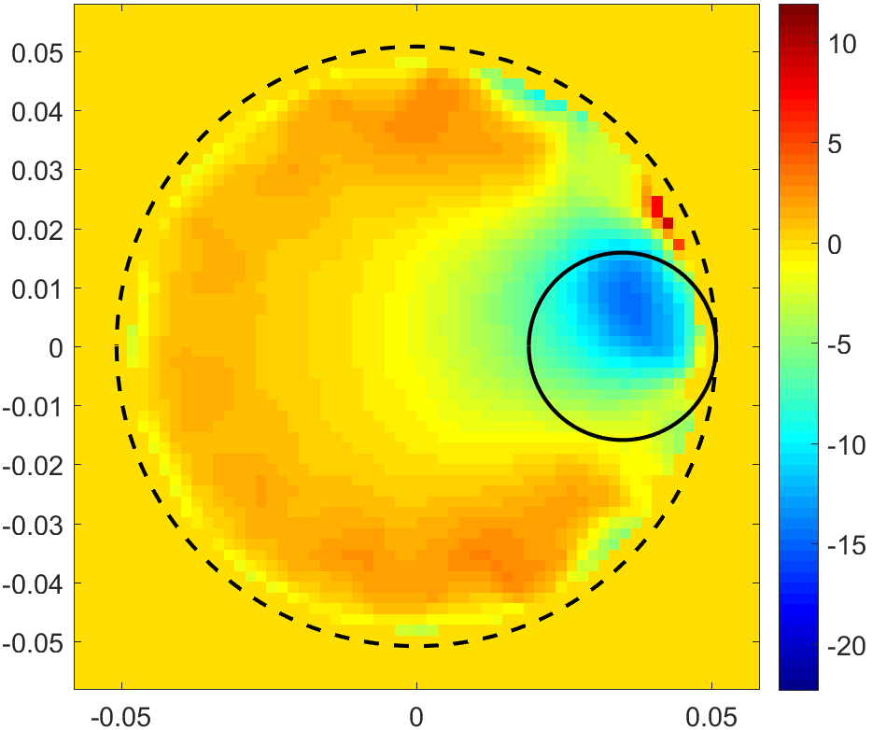
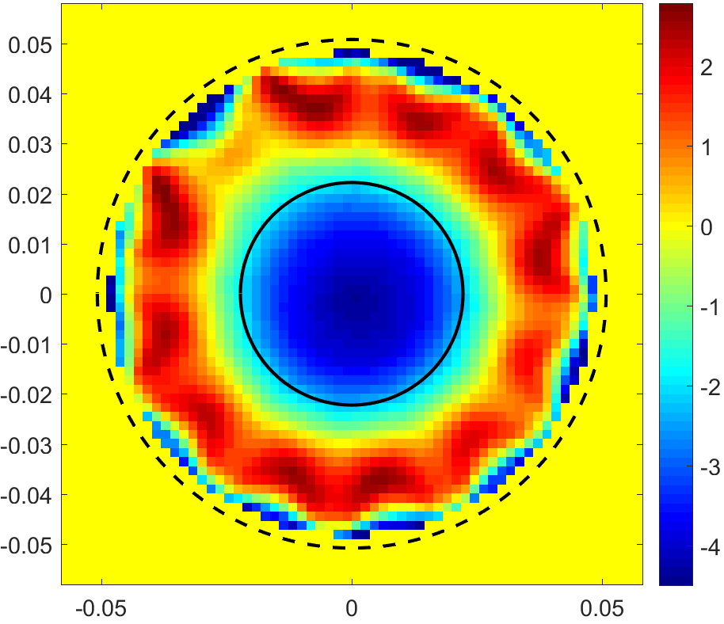
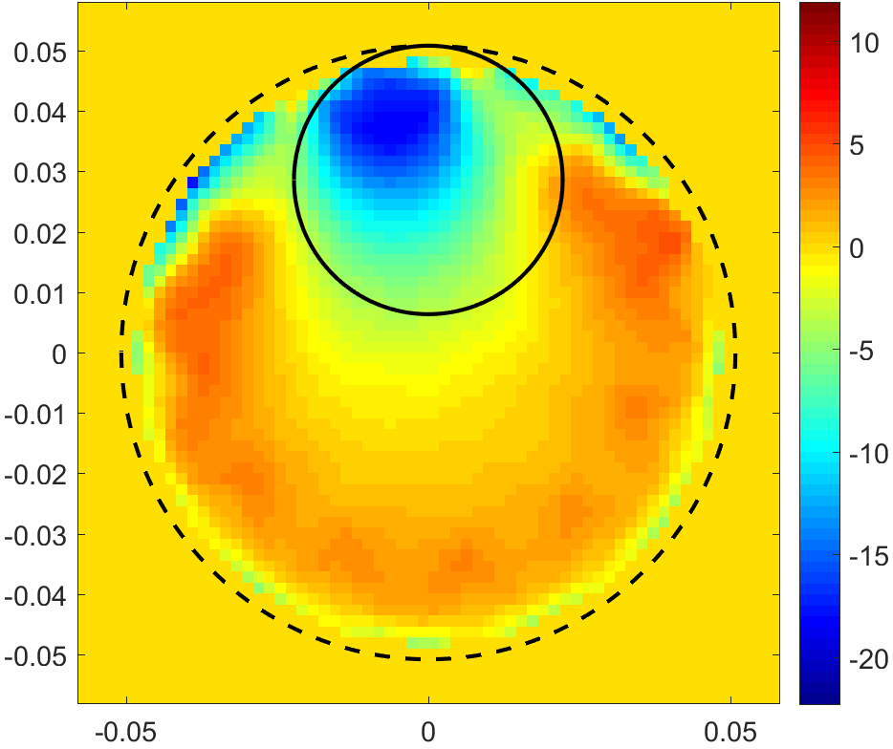
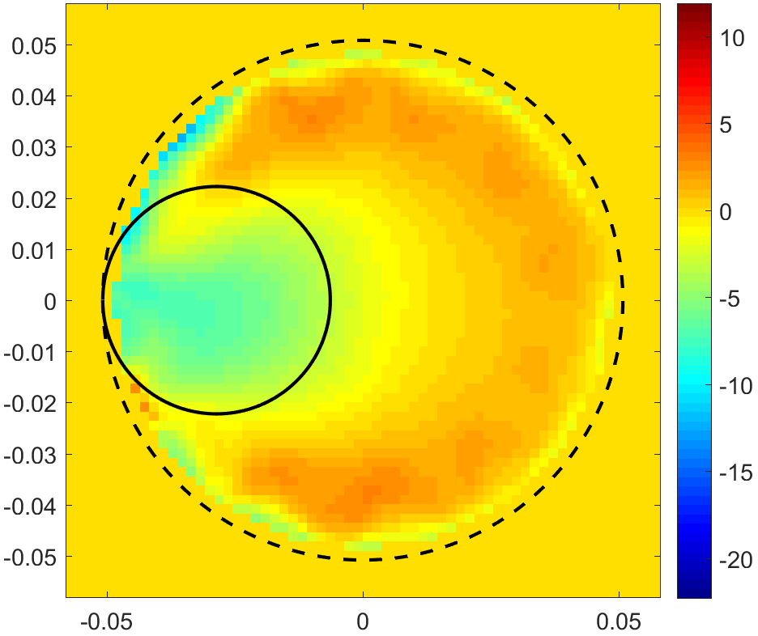
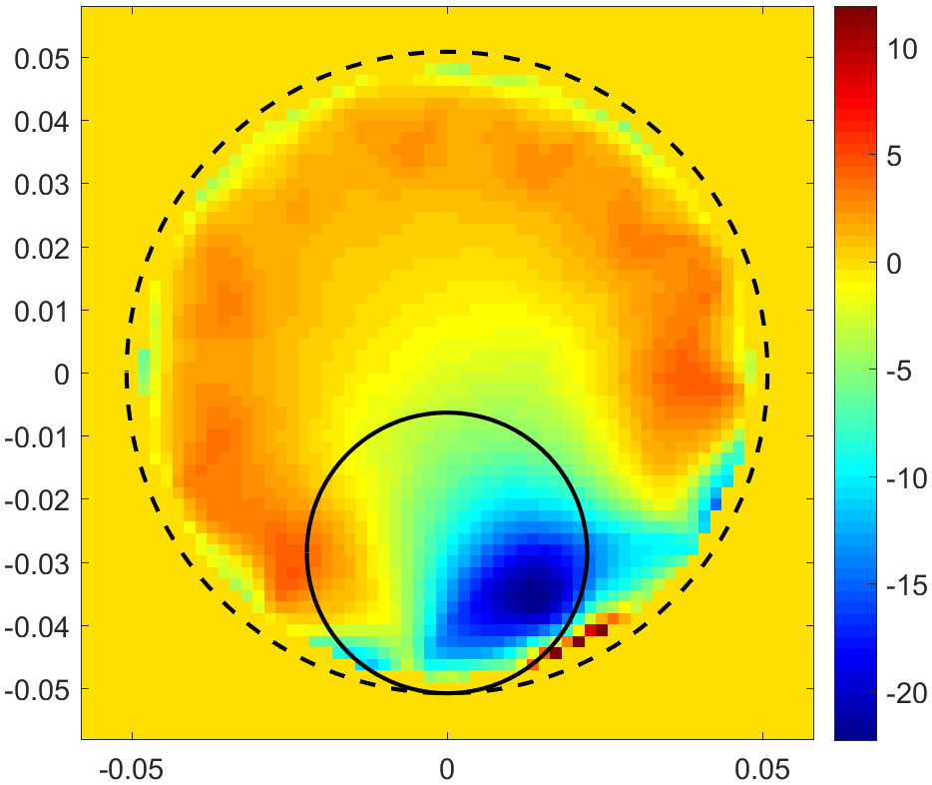
DCPT Experiment With abs(S) Matrix
$ε={80ε}_{0}$ $σ=5.5{×10}^{−6}\left(\frac{S}{m}\right)$
$$f=2MHz λ=150m$$
$$δ=\sqrt{\frac{2}{ωμσ}}≈151m$$
$$\frac{σ}{ωε}\sim 6{×10}^{−5}$$
$$64×64 \text{Pixels}$$

Slide 15
Multi-Frequency &Three Phase Imaging
A – Air
B – Water
C - Oil
Phase C
Cross-section of 3 phase system
Decomposition of 3 Phases

Slide 16
Multi-Frequency &Three Phase Imaging
A – Air
B – Water
C - Oil
Phase A
Phase C
Cross-section of 3 phase system
Decomposition of 3 Phases

Slide 17
Multi-Dimensional Approach
Capacitance
Sensor
Φ, A, ω, $\frac{dnφ }{df^{n}},\frac{dnA }{df^{n}}$, S,
$\frac{dn S}{dX^{n}}$, $\frac{dn S}{dY^{n}}$ , $\frac{dn S}{dZ^{n}}$ , $\frac{dnφ }{dt^{n}}$ , $\frac{dnA }{dt^{n}}$
Signal
Data
Acquisition
System
Current Phase, Capacitance, and Frequency Data
Processing System
Final Output
Imaging or Quantification
Typical ECVT Sensor
Signal Flow

Slide 18
Multi-Dimensional Approach
Stage 1
Decision
Stage 2
Measurement
Stage 3
Analysis
Stages of the Multi-Dimensional Approach
Stage 1
Decision
Stage 2
Measurement
Stage 3
Analysis
Stages of the Multi-Dimensional Approach With Feedback

Slide 19
Multi-Dimensional Approach
Known system parameters (e.g. volume, shape, no. of phases, permittivity, conductivity, etc)
Properties to be measured or imaged (e.g. phase distribution, velocity, temperature)
Are the known parameters and available data from sensor enough to measure the required properties?
Yes
No
Determine which dimensions to use based on linearity and slope of frequency transition points
Collect data from the sensor
Φ, A, ω, $\frac{dnφ }{df^{n}},\frac{dnA }{df^{n}}$, S,
$\frac{dn S}{dX^{n}}$, $\frac{dn S}{dY^{n}}$ , $\frac{dn S}{dZ^{n}}$ , $\frac{dnφ }{dt^{n}}$ , $\frac{dnA }{dt^{n}}$
Stage 2
Estimate new system parameters
ϕ = Displacement Phase Current
A = Current Amplitude or Capacitance
ω = Excitation Frequency
n = level of derivative
X, Y, Z = spatial axes
t = time axis
f = frequency axis
S = Geometry of the smart sensor
Stage 1 of the Multi-Dimensional Approach

Slide 20
Multi-Dimensional Approach
Stage 1
Stage 2
Calibrate DAS according to known or estimated system parameters
Generate system of equations
Collect data according to the optimal dimensions determined to use in Stage 1
Solve system of equations with collected data from Stage 2
Generate images or quantified data of the properties to be measured
Stage 3
Stage 2 of the Multi-Dimensional Approach
Stage 3 of the Multi-Dimensional Approach

Slide 21
Conclusion
Multi-dimensional imaging using capacitance sensors is based on exploring independent dimensions in measured signal from the same sensors.
Additional dimensions enable more degrees of freedom to measure multiphase flow system.
In addition; capacitance data, phase information, frequency information, and derivatives are used to imaging multiple phases simultaneously.

